Slide 1

Lab 09 THE CONSOLE
Prof. Davide Brunelli
Dept. of Industrial Engineering – DII
University of Trento, Italy
davide.brunelli@unitn.it

Slide 2
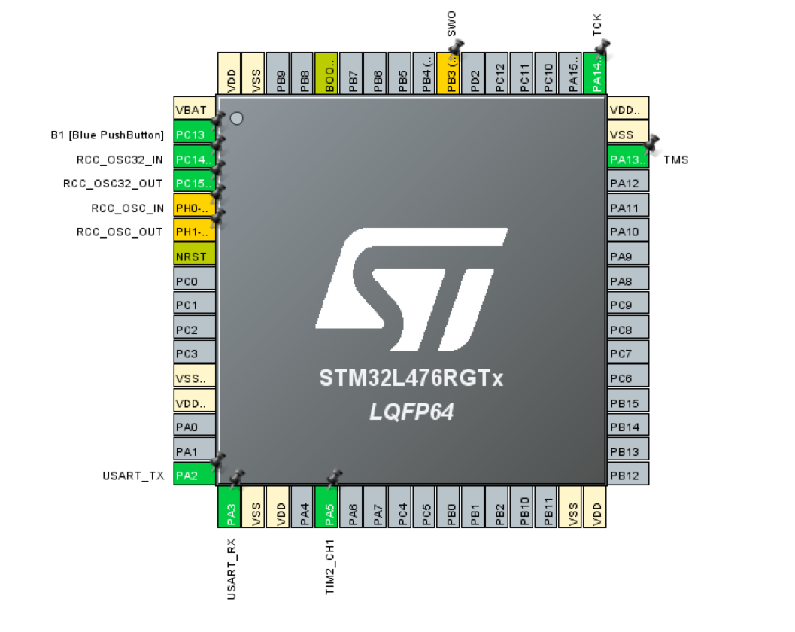
STM32 USART
Nucleo boards directly connect USART RX/TX pins to the miniUSB port integrated in the STLink
PA2 = TX
PA3 = RX
2

Slide 3
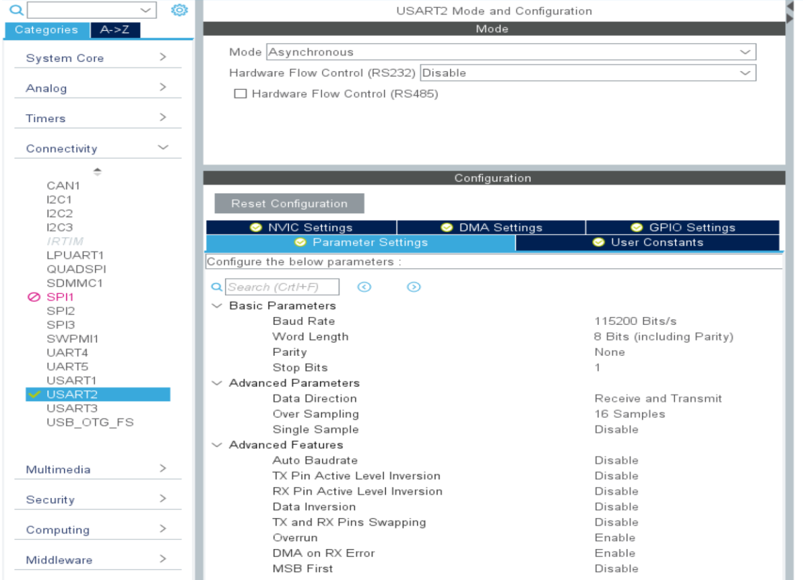
STM32 USART
Check that the USART2 is enabled.
3

Slide 4
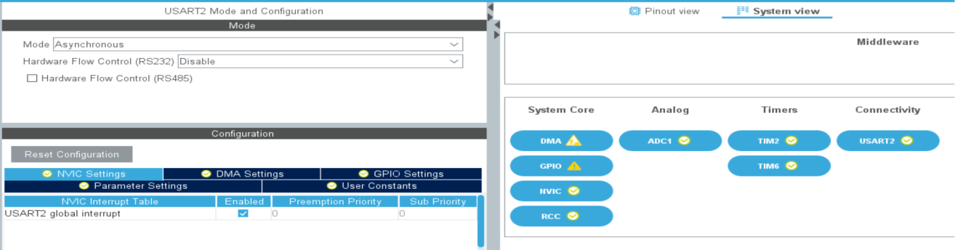
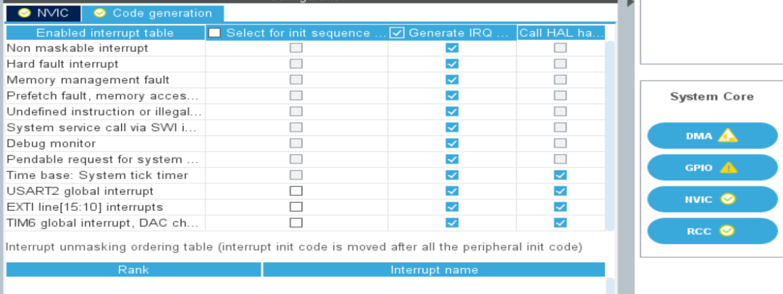
STM32 Console
Enable the USART interrupt.
Remember to double check under “code generation” if IRQ generation is enabled
4

Slide 5
STM32 Console
Once everything is configured and the code generated, we have to add the callback called when the USART receive a character.
In the callback, we take care of echoing back user input and storing it inside a buffer (defined as global variables).
#define MAXBUFFSIZE 100
uint8_t RxBuf [MAXBUFFSIZE];
uint8_t TxBuf [MAXBUFFSIZE];
void HAL_UART_RxCpltCallback(UART_HandleTypeDef *huart){
if(RxBuf[0] == '\r’){ // Check new line
HAL_UART_Transmit(&huart2, (uint8_t *)"\r\n", sizeof("\r\n"),10);
//cmd_check(); //TO BE IMPLEMENTED!!
}
else if(RxBuf[0] == '\b’){ //Check back space
HAL_UART_Transmit(&huart2, (uint8_t *)"\b \b", sizeof("\b \b"),10);
TxBuf[--char_counter] = NULL;
}else{ //Otherwise store inside our buffer
TxBuf[char_counter++] = RxBuf[0];
HAL_UART_Transmit(&huart2, (uint8_t *) RxBuf, sizeof(RxBuf),10); //Echoing
}
HAL_UART_Receive_IT(&huart2 , RxBuf, 1); // Restart UART in Interrupt mode
}
5

Slide 6
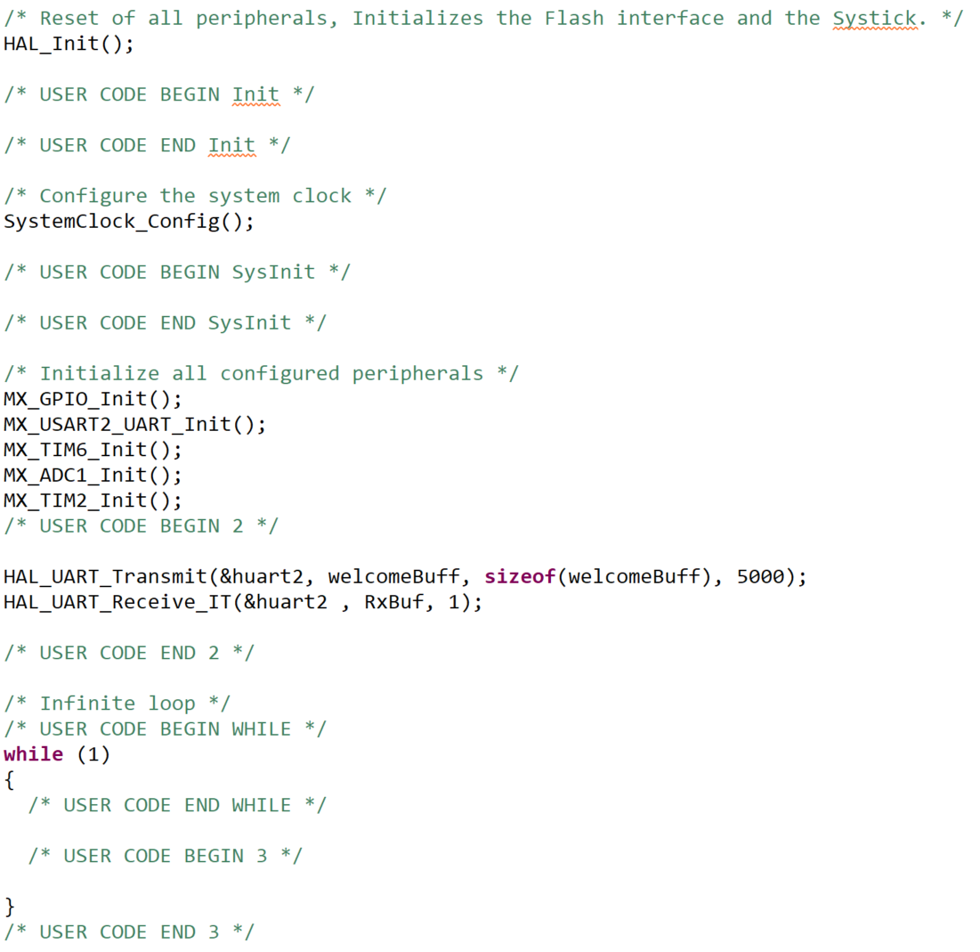
STM32 Console
Finally start the UART in interrupt mode.
6

Slide 7
ADC
CONSOLE – INTERACT WITH THE EMBEDDED SYSTEM

Slide 8
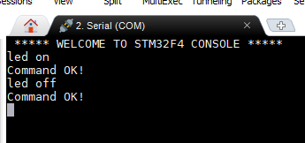
6d orientation estimator
Create a console program, that recognize a set of commands and execute them on
board.
Switch LED ON and OFF
Toggle LED
Start LED blinking
Get internal temperature
Hint: you can use strcmp((char *)TxBuf, command) to compare two strings
8

